Slide 1
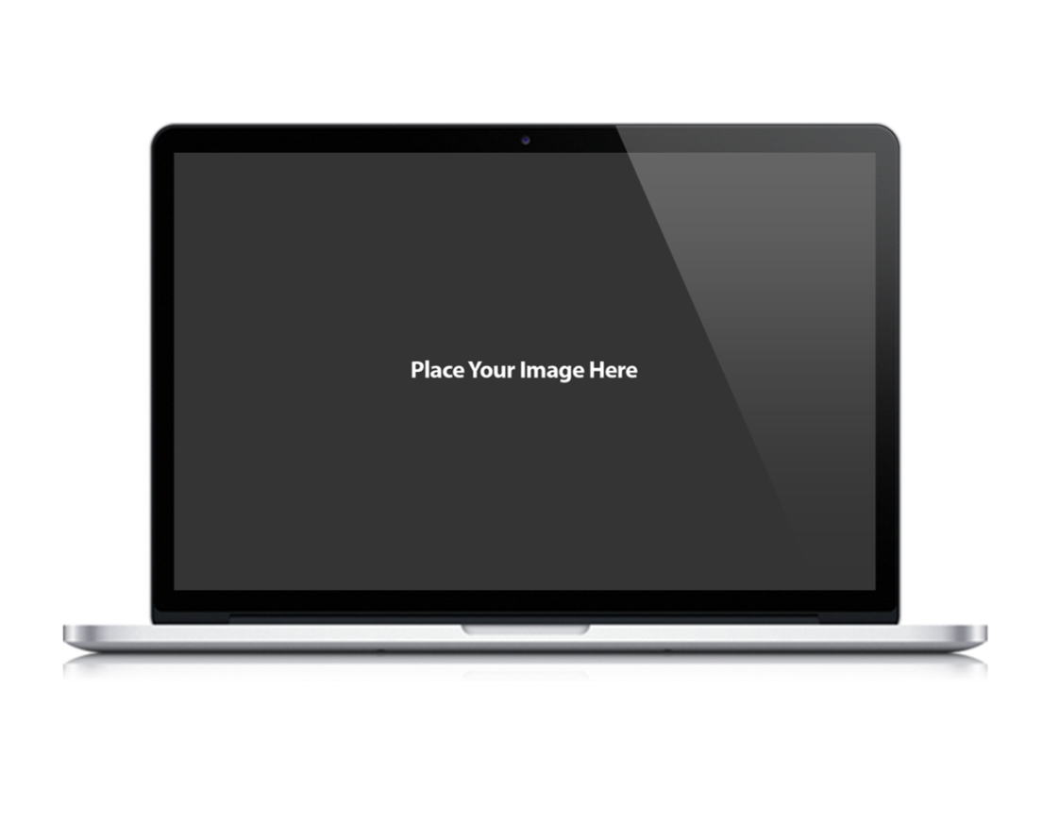
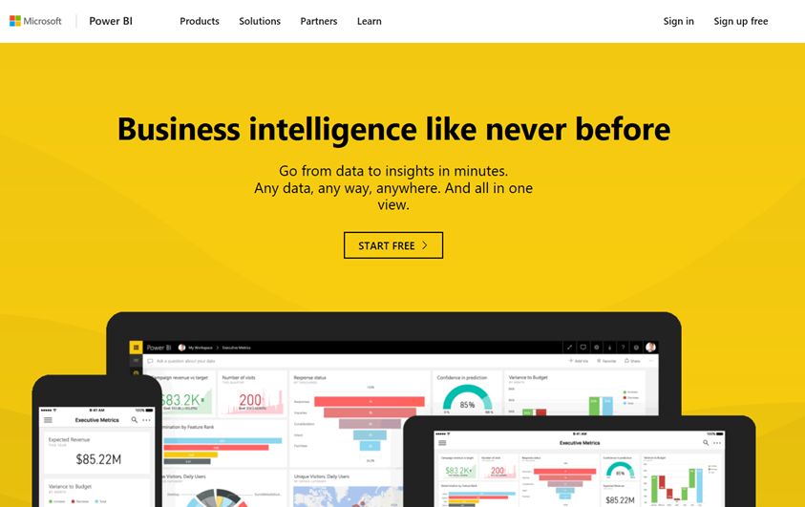
CAT
Microsoft Power BI
App-Owns-Data Starter Kit
Ted Pattison Power BI Customer Advisory Team (PBICAT)

Slide 2
App-Owns-Data Embedding and Multi-tenancy
Tenant represents a customer with one or more users
you must create a separate tenant for each customer
Provisioning a new customer tenant
create a Power BI workspace
assign workspace to a dedicated capacity
import PBIX files
patch datasource credentials
start dataset refresh operations
create and bind gateway datasources

Slide 3
App-Owns-Data embedding and Authorization
Power BI doesn’t know anything about your users
Power BI cannot provide assistance when it comes to authorization
Not an issue in scenario where all users see all content with the same access
Your application must add explicit support for any authorization scheme
Key observations about App-Owns-Data embedding
you have flexibility to design the authorization scheme any way you'd like
you have responsibility to build authorization scheme from the ground up
you should use custom database to track the authorization data you need

Slide 4
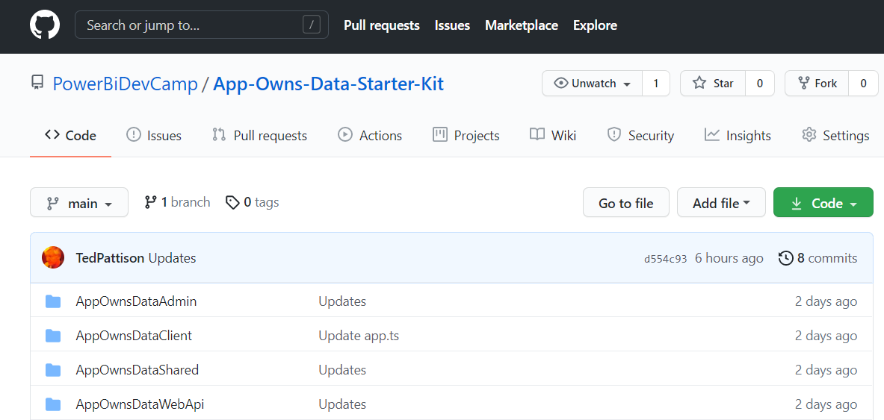
App-Owns-Data Starter Kit
Available in a public GitHub repository
https://github.com/PowerBiDevCamp/App-Owns-Data-Starter-Kit

Slide 5
App-Owns-Data Starter Kit - Value Proposition
Provides guidance and starter code for the following tasks
Onboarding new customer tenants
Managing user permissions
Implementing the customer-facing client as a Single Page Application (SPA)
Creating a custom telemetry layer to log user activity
Monitoring user actions such as ViewReport, EditReport and CreateReport
Monitoring the performance of report loading and rendering

Slide 6
Solution Architecture
AppOwnsDataAdmin
AppOwnsDataDB
Power BI REST API
AppOwnsDataClient
AppOwnsDataWebAPI

Slide 7
AppOwnsDataAdmin
AppOwnsDataAdmin
Power BI REST API
Azure AD Service App
AppOwnsDataDB

Slide 8
Web API Architecture
AppOwnsDataClient
AppOwnsDataWebAPI
Power BI REST API
Azure AD Client App
Azure AD Service App
AppOwnsDataDB

Slide 9

Web API User Login
AppOwnsDataClient
/api/UserLogin/
AppOwnsDataWebAPI

Slide 10
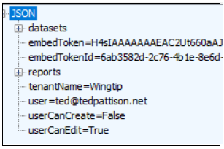
Web API ViewModel
/api/Embed/
AppOwnsDataClient
AppOwnsDataWebAPI

Slide 11
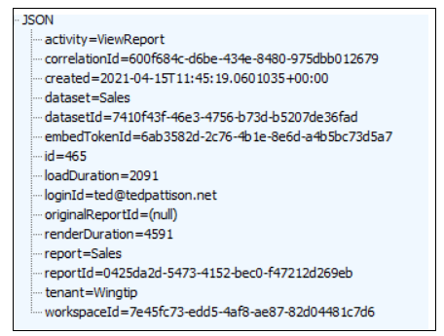
Logging
/api/ActivityLog/
AppOwnsDataClient
AppOwnsDataWebAPI
AppOwnsDataDB

